Slide 1





Data Access with ADO.NET
Accessing SQL Server and OLE DB from .NET
Svetlin Nakov
Telerik Corporation
www.telerik.com

Slide 2

Table of Contents
Data Access Models – Connected, Disconnected, ORM
ADO.NET Architecture and Data Providers
Accessing SQL Server (Connected Model)
Using SqlConnection , SqlCommand and SqlDataReader
Parameterized Queries
Accessing Other Databases

Slide 3
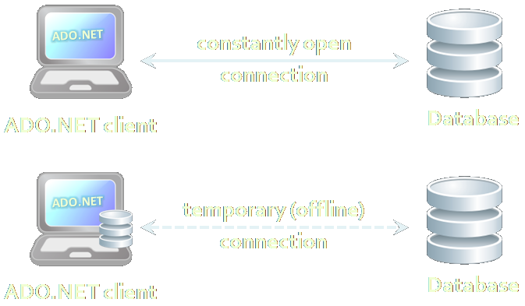

Data Access Models

Slide 4


Connected Model
Connected data access model
Applicable to an environment where the database is constantly available
Too much effort to issue SQL commands by hand
ADO.NET
constantly open
connection
DB
DB
ADO.NET client
Database

Slide 5

Disconnected Model
Disconnected data access model
A subset of the central database is copied locally at the client and he works with the copy
Database synchronization is done offline
ADO.NET
temporary (offline)
connection
DB
DB
ADO.NET client
Database

Slide 6
ORM Model
ORM data access model
Maps database tables to classes and objects
Objects can be automatically persisted in the database
Can operate in both connected and disconnected modes
OO
Programming
Language
ORM
Framework
Database

Slide 7
ORM Model: Benefits and Problems
ORM model benefits
Increased productivity – writing less code
Use objects with associations instead of tables and SQL commands
Integrated object query mechanism
ORM model drawbacks:
Less flexibility – SQL is automatically generated
Performance issues (sometimes)

Slide 8
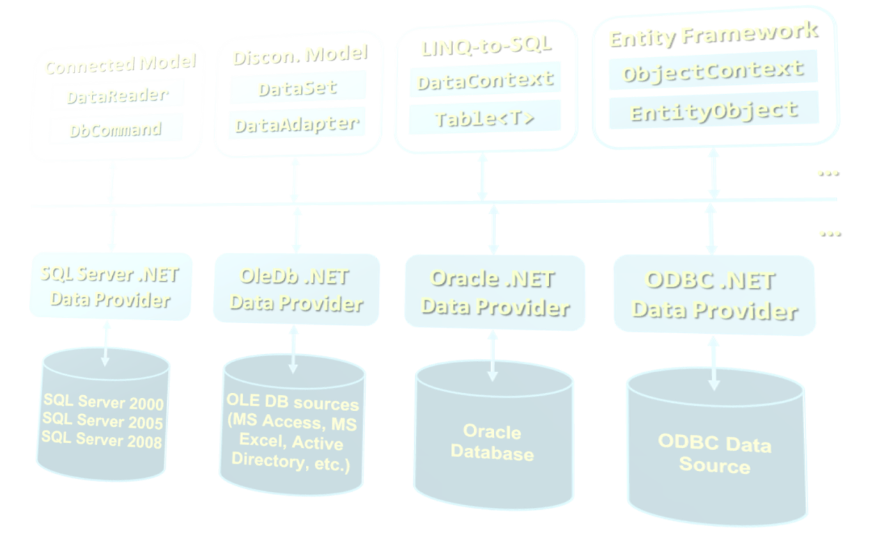
ADO.NET Architecture

Slide 9
What is ADO.NET?
ADO.NET is a standard .NET class library for accessing databases, processing data and XML
An API for working with data in .NET
Supports connected, disconnected and ORM data access models
Excellent integration with LINQ, XML and WCF
Allows executing SQL in RDBMS systems
DB connections, data readers, DB commands
Supports the ORM approach
LINQ-to-SQL and ADO.NET Entity Framework

Slide 10
Namespaces in ADO.NET
System.Data
ADO.NET core classes
System.Data.Common
Common classes for all ADO.NET technologies
System.Data.Linq
LINQ to SQL framework classes
System.Data.Entity
Entity Framework classes
System.Xml
XML processing classes

Slide 11
Components of ADO.NET
Connected Model
Disconn. Model
LINQ-to-SQL
Entity Framework
DataReader
DataSet
DataContext
ObjectContext
DbCommand
DataAdapter
Table<T>
EntityObject
ADO.NET
Programming Model
…
…
SQL Server .NET Data Provider
OleDb .NET Data Provider
Oracle .NET Data Provider
ODBC .NET Data Provider

Slide 12
Data Providers in ADO.NET
Data Providers are collections of classes that provide access to various databases
For different RDBMS systems different Data Providers are available
Each provider uses vendor-specific protocols to talk to the database server
Data providers define several common objects:
Connection – to connect to the database
Command – to execute an SQL command
DataReader – to retrieve data
Entity Framework support (optionally)

Slide 13
Data Providers in ADO.NET (2)
Several standard ADO.NET Data Providers come as part of .NET Framework
SqlClient – accessing SQL Server
OleDB – accessing standard OLE DB data sources
Odbc – accessing standard ODBC data sources
Oracle – accessing Oracle database
Third party Data Providers are available for:
MySQL, PostgreSQL, Interbase, DB2, SQLite
Other RDBMS systems and data sources

Slide 14
Third Party Data Providers
ADO.NET Driver for MySQL (Connector/NET)
http://www.mysql.com/products/connector/
Supports Entity Framework (from version 6.0)
Oracle Data Provider for .NET (ODP.NET)
http://www.oracle.com/technetwork/topics/dotnet
Does not support Entity Framework
.NET Data Provider for PostgreSQL
http://npgsql.projects.postgresql.org/
Supports Entity Framework

Slide 15
Standard Data Provider Classes
System.Data.SqlClient and System.Data.SqlTypes
Data Provider classes for accessing SQL Server
System.Data.OleDb
Classes for accessing OLE DB data sources
System.Data.Odbc
Classes for accessing ODBC data sources
System.Data.Oracle
Classes for accessing Oracle databases

Slide 16
ADO.NET: Connected Model
Retrieving data in connected model
Open a connection (SqlConnection)
Execute command (SqlCommand)
Process the result set of the query by using a reader (SqlDataReader)
Close the reader
Close the connection
SqlDataReader
SqlParameter
SqlParameter
SqlCommand
SqlParameter
SqlConnection
Database

Slide 17
ADO.NET: Disconnected Model
Disconnected model – data is cached in a DataSet
Open a connection (SqlConnection)
Fill a DataSet (using SqlDataAdapter)
Close the connection
Modify the DataSet
Open a connection
Update changes into the DB
Close the connection
DataSet
SqlDataAdapter
SqlConnection
Warning:
DataSets / DataAdapters are legacy technology. Not used since .NET 3.5.
Database

Slide 18
ADO.NET: LINQ to SQL
LINQ to SQL is ORM framework for SQL Server
Create object models mapping the database
Open a data context
Retrieve data with LINQ / modify the tables in the data context
Persist the data context changes into the DB
Connection is auto-closed
Table
Table
Table
DataContext
SqlConnection
Database

Slide 19
ADO.NET: Entity Framework
Entity Framework is generic ORM framework
Create entity data model mapping the database
Open an object context
Retrieve data with LINQ / modify the tables in the object context
Persist the object context changes into the DB
Connection is auto-closed
Entity
Entity
Entity
ObjectContext
EntityClient
Data Provider
SqlConnection
Database

Slide 20

SQL Client Data Provider
SQL

Slide 21
SqlClient Data Provider
SqlConnection
Establish database connection to SQL Server
SqlCommand
Executes SQL commands on the SQL Server through an established connection
Could accept parameters (SQLParameter)
SqlDataReader
Retrieves data (record set) from SQL Server as a result of SQL query execution

Slide 22
The SqlConnection Class
SqlConnection holds a connection to SQL Server database
Requires a valid connection string
Connection string example:
Connecting to SQL Server:
Data Source=(local)\SQLEXPRESS;Initial Catalog=Northwind;Integrated Security=SSPI;
SqlConnection con = new SqlConnection(
"Server=.\SQLEXPRESS;Database=Northwind;
Integrated Security=true");
con.Open();

Slide 23
Connection String
Database connection string
Defines the parameters needed to establish the connection to the database
Main parameters for SQL Server connections:
Provider – name of the DB driver
Data Source / Server – server name / IP address + database instance name
Database / Initial Catalog – database name
User ID / Password – credentials

Slide 24
Connection String (2)
Main parameters for SQL Server connections:
AttachDbFilename=some_db.mdf
Attaches a local database file at startup
Supported by SQL Express only
Server=server_name\database_instance
"." or "(local)" or "SOME_SERVER"
Database instance is "MSSQL", "SQLEXPRESS" or other SQL Server instance name
Integrated Security – true / false

Slide 25
Working with SqlConnection
Explicitly opening and closing a connection
Open() and Close() methods
Works through the connection pool
Implicitly opening and closing the connection
Done automatically by DataAdapters, DataContexts and ObjectContexts
Connections are IDisposable objects
Can be managed with the using construct

Slide 26
SqlConnection – Example
Creating and opening connection to SQL Server (database TelerikAcademy)
SqlConnection dbCon = new SqlConnection(
"Server=.\\SQLEXPRESS; " +
"Database=TelerikAcademy; " +
"Integrated Security=true");
dbCon.Open();
using(dbCon)
{
// Use the connection to execute SQL commands here …
}

Slide 27
ADO.NET Classes for the Connected Model
SqlDataReader
XmlReader
SqlCommand
SqlParameter
SqlParameter
SqlConnection
SqlParameter
Database

Slide 28
SqlClient and ADO.NET Connected Model
Retrieving data in connected model
Open a connection (SqlConnection)
Execute command (SqlCommand)
Process the result set of the query by using a reader (SqlDataReader)
Close the reader
Close the connection
SqlDataReader
SqlParameter
SqlParameter
SqlCommand
SqlParameter
SqlConnection
Database

Slide 29
The SqlCommand Class
Executes an SQL statement or a stored procedure
More important properties
Connection – gets / sets the SqlConnection of the command
CommandType – the type of the command
CommandType.StoredProcedure
CommandType.TableDirect
CommandType.Text
CommandText – the body of the SQL query or the name of the stored procedure
Parameters

Slide 30
The SqlCommand Class (2)
More important methods
ExecuteScalar()
Returns a single value (the value in the first column of the first row of the result set)
The returned value is System.Object but can be casted to the actual returned data type
ExecuteReader()
Returns a SqlDataReader
It is a cursor over the returned records (result set)
CommandBehavior – assigns some options

Slide 31
The SqlCommand Class (3)
More important methods
ExecuteNonQuery()
Used for non-query SQL commands, e.g. INSERT
Returns the number of affected rows (int)
ExecuteXmlReader()
Returns the record set as XML
Returns an XmlReader
Supported in SqlClient Data Provider only

Slide 32
The SqlDataReader Class
SqlDataReader retrieves a sequence of records (cursor) returned as result of an SQL command
Data is available for reading only (can't be changed)
Forward-only row processing (no move back)
Important properties and methods:
Read() – moves the cursor forward and returns false if there is no next record
Item (indexer) – retrieves the value in the current record by given column name or index
Close() – closes the cursor and releases resources

Slide 33
SqlCommand – Example
SqlConnection dbCon = new SqlConnection(
"Server=.\\SQLEXPRESS; " +
"Database=TelerikAcademy; " +
"Integrated Security=true");
dbCon.Open();
using(dbCon)
{
SqlCommand command = new SqlCommand(
"SELECT COUNT(*) FROM Employees", dbCon);
decimal employeesCount = command.ExecuteScalar();
Console.WriteLine("Employees count: {0} ",
employeesCount);
}

Slide 34
SqlDataReader – Example
SqlConnection dbCon = new SqlConnection(…);
dbCon.Open();
using(dbCon)
{
SqlCommand command = new SqlCommand(
"SELECT * FROM Employees", dbCon);
SqlDataReader reader = command.ExecuteReader();
using (reader)
{
while (reader.Read())
{
string firstName = (string)reader["FirstName"];
string lastName = (string)reader["LastName"];
decimal salary = (decimal)reader["Salary"];
Console.WriteLine("{0} {1} - {2}",
firstName, lastName, salary);
}
}
}

Slide 35

The SqlParameter Class
What are SqlParameters?
SQL queries and stored procedures can have input and output parameters
Accessed through the Parameters property of the SqlCommand class
Important properties of SqlParameter:
ParameterName – name of the parameter
DbType – SQL type (NVarChar, Timestamp, …)
Size – size of the type (if applicable)
Direction – input / output

Slide 36
Parameterized Commands – Example
private void InsertProject(string name, string description,
DateTime startDate, DateTime? endDate)
{
SqlCommand cmd = new SqlCommand("INSERT INTO Projects " +
"(Name, Description, StartDate, EndDate) VALUES " +
"(@name, @desc, @start, @end)", dbCon);
cmd.Parameters.Add(new SqlParameter("@name", name));
cmd.Parameters.Add(new SqlParameter("@desc", description));
cmd.Parameters.Add(new SqlParameter("@start", startDate));
SqlParameter sqlParameterEndDate =
new SqlParameter("@end", endDate);
if (endDate == null)
sqlParameterEndDate.Value = DBNull.Value;
cmd.Parameters.Add(sqlParameterEndDate);
cmd.ExecuteNonQuery();
}

Slide 37
Primary Key Retrieval
Retrieval of an automatically generated primary key is specific to each database server
In SQL Server IDENTITY column is used
Obtained by executing the following query:
Example of obtaining the automatically generated primary key in ADO.NET:
SELECT @@Identity
SqlCommand selectIdentityCommand =
new SqlCommand("SELECT @@Identity", dbCon);
int insertedRecordId = (int)
(decimal) selectIdentityCommand.ExecuteScalar();

Slide 38



Connecting to Non-Microsoft Databases

Slide 39
Connecting to Non-Microsoft Databases
ADO.NET supports accessing various databases via their Data Providers:
OLE DB – supported internally in ADO.NET
Access any OLE DB-compliant data source
E.g. MS Access, MS Excel, MS Project, MS Exchange, Windows Active Directory, text files
Oracle – supported internally in ADO.NET
MySQL – third party data provider
PostgreSQL – third party data provider

Slide 40
ADO.NET Data Interfaces
ADO.NET Data Providers implement the following interfaces:
IDbConnection
IDbCommand, IDataParameter
IDataReader
IDbDataAdapter

Slide 41
ADO.NET Base Classes
ADO.NET provides the following base classes:
DbConnection
DbCommand / DbParameter
DbDataReader
DbTransaction
DbParameterCollection
DbDataAdapter
DbCommandBuilder
DbConnectionStringBuilder
DbDataPermission

Slide 42
OLE DB Data Provider
OleDbConnection – establishes a connection to an OLE DB source of data
OleDbCommand – executes an SQL commands through an OLE DB connection to a DB
OleDbParameter – parameter for a command
OleDbDataReader – to retrieve data from a command, executed through OLE DB
OleDbConnection dbConn = new OleDbConnection(
@"Provider=Microsoft.Jet.OLEDB.4.0;Data
Source=C:\MyDB.mdb;Persist Security Info=False");

Slide 43

Connecting To OLE DB – Example
Suppose we have MS Access database C:\Library.mdb
We have the table Users:
We use the "Microsoft Jet 4.0 Provider" to connect in ADO.NET through OLE DB
We create a connection string component:
Provider=Microsoft.Jet.OLEDB.4.0;Data Source= C:\Library.mdb;Persist Security Info=False

Slide 44
Data Access with ADO.NET
?
?
?
?
?
Questions?
?
?
?
?
?
?

